Slide 1
Data structures and algorithm
Doubly Linked List
Dr. Seemab Latif
Lecture No. 9
22nd October, 2010

Slide 2
Introduction
The singly linked list contains only one pointer field i.e. every node holds an address of next node.
The singly linked list is uni-directional i.e. we can only move from one node to its successor.
This limitation can be overcome by Doubly linked list.

Slide 3
Doubly Linked List
In Doubly linked list, each node has two pointers.
One pointer to its successor (NULL if there is none) and one pointer to its predecessor (NULL if there is none).
These pointers enable bi-directional traversing.
*Previous
Data
*Next

Slide 4
A Singly Linked List
Head
A Doubly Linked List
Head

Slide 5
Comparison of Linked Lists
Linked list
struct Node {
int data;
Node* next;
};
Doubly linked list
struct Node {
Node *previous;
int data;
Node *next;
};

Slide 6
Insertion
In insertion process, element can be inserted in three different places
At the beginning of the list
At the end of the list
At the specified position.
To insert a node in doubly linked list, you must update pointers in both predecessor and successor nodes.

Slide 7
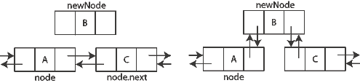
Insertion

Slide 8
Deletion
In deletion process, element can be deleted from three different places
From the beginning of the list
From the end of the list
From the specified position in the list.
When the node is deleted, the memory allocated to that node is released and the previous and next nodes of that node are linked

Slide 9
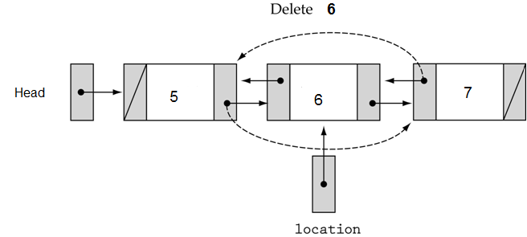
Deletion

Slide 10
Advantages of Doubly Linked List
The doubly linked list is bi-directional, i.e. it can be traversed in both backward and forward direction.
The operations such as insertion, deletion and searching can be done from both ends.
Predecessor and successor of any element can be searched quickly

Slide 11
Disadvantages
It consume more memory space.
There is a large pointer adjustment during insertion and deletion of element.
It consumes more time for few basic list operations.

